Slide 1
Brief Counseling in Schools
"Time is a finite resource and we all place infinite demands on it. I view time as an opportunity, as a chance to make choices about how I spend that resource -- because it is our choice. And that's something people often forget." -- Maggie Wilderotter
Notes:
What does the day of a school counselor look like?
For me at my internship it is hectic and each day is different.
During a period (45-50 min) I am likely to see 5 students, and my supervisor is able to see many more.
What are some barriers to counseling at your school?
Time… it is always time and which is a finite resource.

Slide 2
Professional School Counselor
Time Distribution for a
Comprehensive Program:
Notes:
How do you use your time at your internship? What are some barriers and challenges you face each day? Does your day look like this?

Slide 3
Objectives
Become more familiar with brief counseling, highlighting Solution-Focused Brief Counseling
Provide tools to implement in your internship site
Give you some literature and other resources for you to take with you.

Slide 4
Brief Counseling
“I think the development of psychiatric skill consists in a very considerable measure of doing a lot with a very little ---- making rather precise move which has a high probability of achieving what you are attempting to achieve, with a minimum of time and words.” – Harry Sullivan
Notes:
What is happening at your school?
How does it look different at each level?
Do you notice specific interventions being used?
Solution-Focused, Reality/Choice Theory, Motivational Interviewing
What is your level of knowledge with these theories?
Fist of 5

Slide 5
Common Factors for Change
Notes:
Clients account for 40% of their successful outcomes, Factors could include persistence, openness, faith, optimism, and family, or spirituality. As well as innerstrength, luck, and outside influences
The perception of the relationship with the counselor is the next largest slice of the pie. The partnership bw the client and the helper with is based on strong agreement of goals and tasks of therapy. The favorable ratings of the allieance is the best predictor of success, more so than diagnosis, approach, therapist or anything else!
Expectancy or Placebo accounts for 15%, which is derived from the clients knowledge of being helped, the instillation of hope, and how credible the client perceives your rationale and techniques. They do not come from the actual procedure but tfrom the expectancy and hopefullness of the techniques
Model/tecniques a ccount for 15%: this could be the miracle questions, or challenging cognitive beliefs, or onfrontation in 12-step work. Remember not one technique has been proven to be better than any other.

Slide 6
Brief Counseling Theoretical Orientation:
Post Modernist:
Human experience is complex
There is no absolute reality
Reality is socially constructed
Social Constructionist:
People are healthy
Everyone’s reality is valid
Each person’s life is continuously developing
Solution-focused, Narrative, Collaborative Therapy

Slide 7
3 Assumptions of Brief Counseling
The problem the client presents is the problem.
Client’s have the necessary resources to deal with their problems, though they may not recognize it.
Small changes can be meaningful, and all that is necessary.
Notes:
1. Counselors take the client at face value and do not spend time searching for deeper, underlying problems.

Slide 8
THE STRUCTURE of Brief Counseling
Precounseling:
Induction, seeding
Early:
Alliance, Pretreatment Change, and Goal Setting
Middle:
Refocus, Change
Late:
Termination, homework, relapse prevention, and leave-taking
Follow through:
Continuation, return, follow up
Notes:
Precounseling Stage: Recognizing that change begins before sessions occur, often with the recognition of a problem and the decision to seek therapy. Find out where they are in the stages of change.
Early: forming a working alliances, assessing patients strengths and weaknesses, and motivations, establishing goals, forming a treatment plan and contract
Middle: staying on task, doing homework, applying the lessons of therapy in real life, assessing treatment and alliance
Late: Termination, avoiding back sliding, a nd self-sabotage,
Followthrough; the client can return form intermittent therapy.

Slide 9
Basic Features of Brief Therapy
Rapid and positive working alliance
Goal Focused
Clear understanding of client and counselor responsibility, high level of counselor activity and client participation
Emphasis on strengths and competencies
Expectation of change (which creates hope).
Present and future orientation
Time Sensitive
(Budman, S. H., Friedman, S., and Hoyt M.F. (1992).

Slide 10
Solution-Focused Therapy
If it ain’t broken, don’t fix it.
Once you know what works do it more.
If it doesn’t work, don’t do it again. “Basic Rules” (de Shazer)
Solution Focused Animation
Notes:
Basic premise: Increase what works and decrease what doesn’t. What are the “exceptions to the problem” what is the patient doien differenctly at the times when the problem doesn’t exsist. What has worked before? What strengths does the client have? What would be a useful solution and how to construct it?

Slide 11
Solution-Focused Counseling
Identify focal problem
Do not underestimate the client
Be prudently active
Explore, and present interpretations tentatively
Encourage the clients expression
Use the interview to start problem solving
Keep track of time
Don’t be overly ambitious
Keep factual questions minimal
Don’t be overly concerned with the past
Avoid detours
Don’t overestimate client’s self-awareness.
General Application

Slide 12
Counselor Role and Relationship
Client is expert on their own life
Counselor has expertise in the process of change
Counselor point client in the direction of change without dictating what change should happen
Customer, Complainant, Visitor relationships with Counselor
Used to reflect on the kind of relationship but not label client
(Budman, S. H., Friedman, S., and Hoyt M.F. (1992).

Slide 13
Solution Talk
Skeleton Key Question:
Between now and the next time we meet I would like you to observe so that you can describe to me, what happens (pick one) that you want to continue.
Miracle Question:
Suppose one night, while you were asleep, there was a miracle…
Endurance (Coping) Question:
Given all you’ve been through, how have you managed to keep going as well has you have?
Efficacy Question:
How did you do that? How did you get that to happen?
Scaling Question:
On a scale from 1 to 10, 1 being absolutely no (hope, motivation, etc) and 10 being complete (hope…)what is your current level, and what would it look like if it went up?
Exceptions Question:
When in the past might the problem have happened but didn’t?
SFT Video

Slide 14
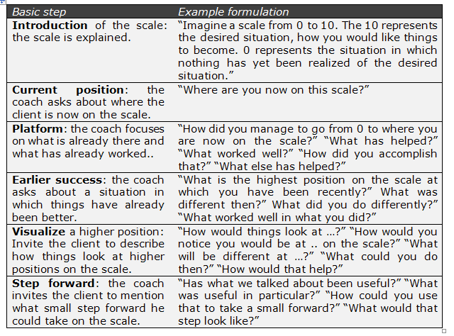
Techniques: Scaling Questions

Slide 15
End of Each Session: Messages and Feedback
Messages:
5-10 minutes
Summary for clients
Compliments
what client’s are doing
Bridge
Links compliments to suggested task
Suggested tasks
Homework: Observational or Behavioral

Slide 16
Assessment and Alignment
Continuous Alignment
Scaled Assessment
Messages and Tasks

Slide 17
Working with Resistancy
Visitor, Complainant, and Customer Type Client:
Reframe Resistance
Speaking clients language
Explore “instead”
Honor client’s preferences
Multiple Perspectives
Many similarities with Motivational Interviewing
Solution Focused
Notes:
Visitor: nurturing parent: soliciting the client’s story and perspectinve, acknowledging the client’s aggravation and commiserating, commending clients decision to come even if they are unhappy about it.encouraging full participation, generating clear and realistic goals.
Complainant: wants the clinician to make the changes, not ready to see themselves as part of the solution.
Customer: jointly identified and agreed on a workable goal.
Exploring clients instead: in place of talking about what to avoid or not to do, ask the client what they would be doing instead. Ex. Student is thinking about avoiding alcohol. Instead actively engage in sober lifestyle.

Slide 18
Resistance VS Change
Can increase resistance by:
Can increase change by:
Arguing for change
Taking expert role
Blaming
Criticizing
Shaming
Labeling
Being in a hurry
Claiming that it will work if done correctly
Open ended questions
Listening reflectively
Affirm positive steps
Summarize effectively
When the client recognizes disadvantages of status quo
And advantages of change
Optimism for change
Expressing intention to change

Slide 19
The Good and the…
Strengths
Challenges
Strength based approach
Tailors to the individual and bases goals on the resources, abilities and needs of the client.
Requires ongoing feedback
Collaborative
Others?
Deceptively simple
Does not take into account power, and systems dynamics
Does not necessarily take into account multicultural considerations
Would not work well with serious mental heath issues
Lack of empirical research
Others?

Slide 20
Multicultural Perspective to Brief Counseling
Strengths:
Does not expect alignment with Dominant Cultures
Emphasis on multiple realities
Explore their own beliefs and provide interpretations
Weaknesses:
Not knowing stance of counselor
Notes:
Are there other techniques you have used at your internships or that you have learned about that you think could be combined with a solution-focused approach?

Slide 21
What have you learned today? What will you take with you?

Slide 22
References:
Budman, S. H., Friedman, S., and Hoyt M.F. (1992). The First Session in brief therapy. New York: Guilford Press.

