Slide 1
Noncognitive Factors
& the Role of the School Counselor
Elizabeth Vaughan 3.4.14

Slide 2

Trending Now
“How Children Succeed” by Paul Tough New York Times Bestseller
Department of Education and Office of Science and Technology Policy “academic mindset” research forum
“No one is born smart. No one is born knowing how to read, right? No one is born knowing how to do math, or no one is born knowing how to play the flute -- all of that comes with a lot of hard work… The only way you know how to read is that you keep trying.”
-- First Lady Michelle Obama at Savoy Elementary School on May 24, 2013
Notes:
From Popular literature to the government – this topic is being talked about
2012 - Tough’s conclusion: noncognitive skills, like persistence, self-control, curiosity, conscientiousness, grit and self-confidence, are more crucial than sheer brainpower to achieving success.
June 2013 - a group of leading researchers, practitioners, and industry representatives convened to discuss how students’ beliefs about their academic abilities and learning potential can affect how much they learn in school and whether they persevere in the face of academic challenges. Research demonstrates that when students learn that their academic ability is not a fixed trait, like eye color, but instead is like a muscle that can grow and develop with hard work, they do better in school. The most dramatic improvements are typically seen in low-performing students, students of color, and females in STEM-related courses.
https://www.ed.gov/edblogs/technology/research/ - DRAFT Report by Office of Educational Technology “Promoting Grit, Tenacity, and Perseverance – Critical Factors for Success in the 21st Century.

Slide 3
What talk have you heard at your school about noncognitive skills?
What are key stakeholders attitudes towards it?

Slide 4
Objectives
Define “noncognitive” factors and their importance in education
Present findings of current literature and debates
Develop strategies for how school counselors can contribute to the growth of non-cognitive skills –specifically academic mindsets

Slide 5
Definition
Cognitive
Noncognitive
Ability: IQ, test scores
involve “substance” of what is learned in school
Skills: “qualities that includes persistence, self-control, curiosity, conscientiousness, grit and self-confidence” (aka personality traits or character)
involve “capacity to learn”
“Grit, Character, and Other Noncognitive skills”
“Teaching Adolescents to Become Learners”
Notes:
Can be difficult to separate there Is an interplay.
Webster definition: of, relating to, being, or involving conscious intellectual activity
Not in dictionary - James Heckman, an economist at the University of Chicago coined the term – noncognitive to describe everything other than cognitive ability that contributed to success
Lit review that we will get to in just a sec they define it more broadly: Cognitive What you learn v noncognitive how you learn (everything that helps a student learn the content.
e “noncognitive” factors—attributes, dispositions, social skills, attitudes, and
intrapersonal resources, independent of intellectual ability—Gov report

Slide 6
Why study noncongnitive factors?
GPA is a “vastly better predictor” of high school and college graduation than standardized test scores.
Those who earned a GED look like high school drop outs on measures like annual income, unemployment rates, divorce rates, or use of illegal drugs
What do GPA and high school diplomas measure that standardized tests scores and GEDs don’t measure?
“Teaching Adolescents to Become Learners”
“Grit, Character, and Other Noncognitive skills”
Notes:
Many studies have shown GPA more predictive
GED study – once again James Heckman economist at the university of Chicago studying “smarter” GED students in comparison to high school graduates – began studying what made the difference? Everything other than sheer intelligence?

Slide 7
Academic Performance
2013 Literature Review
Academic Behaviors
Academic Perseverance
Academic Mindsets
Learning Strategies
Social Skills
Notes:
Took a review of the existing literature and empirical data – found that they could group it into 5 categories that influence academic performance
Academic behaviors - are stuff you can pretty much see. Studying, attending class
Academic perseverance - grit, tenacity, delayed gratification, self-control – think Angela Duckworth
Academic Mindsets are the psycho-social attitudes or beliefs one has about oneself in relation to academic work. (Carol Dyweck)
Learning strategies – time management, goal-setting – “Study Skills”
Social Skills – empathy, cooperation, assertion

Slide 8
“Teaching Adolescents to Become Learners”
Notes:
Behaviors-easy to see and measure, strong effect on grades
Perseverance – moderate relationships to student performance (perseverance is motivated through mindset) “Students will be more likely to persevere when
the learning environment has a fair and respectful climate, conveys high expectations,
emphasizes effort over ability, and provides necessary tangible resources—materials, human,
and time.” – DOE report
Academic mindsets – interventions have shown it can affect performance and it is malleable
Learning strategies – knowing how and when to use learning strategies is associated with higher overall learning and better academic success
Social Skills – more tenuous link – almost all correlational rather than causal

Slide 9

What makes up Academic Mindsets?
I belong in the academic community
My ability and competence grow with effort
I can succeed at this
This work has value for me
Notes:
“Academic mindsets and use of learning strategies have a strong and consistent positive relationship across a wide variety of studies in several different subject areas with students in the middle grades, high school, and college.”
DOE report

Slide 10
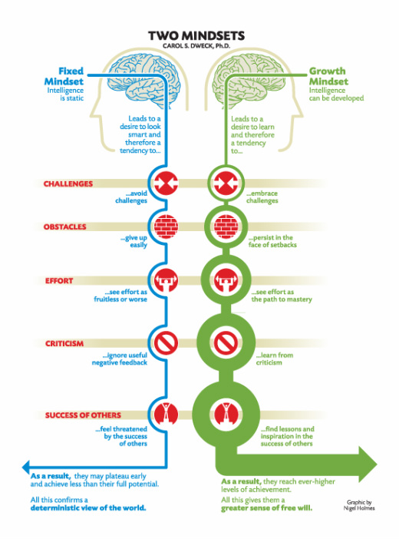
More about Mindsets
Growth Mindset
Fixed Mindset
Intelligence can be developed | Intelligence is static
Embrace challenges | Avoid challenges
Persist in face of setbacks | Give up easily
See effort as path to mastery | See efforts as fruitless
Learn from criticism | Ignore useful negative feedback
Find lessons & inspiration in success of others | Feel threatened by success of others
Reach ever-higher levels of achievement | May plateau early & achieve less than full potential
“Mindset: The New Psychology of Success”
Notes:
Decades of research by Carol Dyweck have focused on the factor of my ability and competence grow with effort

Slide 11

Cross-Cultural Perspectives
Example: “Hard Work” vs. “Exceptional Brain”
Eastern - Encourage process
Western – Applaud traits
Choi & Ross, 2011
Jose & Bellamy, 2012
Notes:
Graduation cards process versus trait
children, aged between 7 and 8 years, from New Zealand, the United States of America, China, and Japan participated in three different school-related tasks. Each of the tasks contained three levels, varying from easy to hard. (Incremental theory of intelligence led to persistence for Eastern culture children)
http://onesearch.library.wwu.edu/primo_library/libweb/action/display.do?frbrVersion=8&tabs=detailsTab&ct=display&fn=search&doc=TN_sagej10.1177_0022022111421633&indx=3&recIds=TN_sagej10.1177_0022022111421633&recIdxs=2&elementId=2&renderMode=poppedOut&displayMode=full&frbrVersion=8&dscnt=0&vl(2497039UI5)=00&scp.scps=scope%3A%28NZ%29%2Cscope%3A%28WWU%29%2Cprimo_central_multiple_fe&tab=default&dstmp=1393927393729&srt=rank&mode=Advanced&&vl(D2497035UI0)=any&vl(1UIStartWith1)=contains&vl(D2497034UI1)=any&vl(2497040UI5)=00&vl(freeText0)=Stigler&vid=WWU&vl(2497041UI5)=Year&vl(2497043UI5)=00&vl(freeText6)=&frbg=&vl(2497042UI5)=00&dum=true&vl(378267593UI6)=any&vl(D2497038UI2)=all_items&vl(D2497036UI4)=all_items&vl(1UIStartWith0)=contains&Submit=OneSearch&vl(2497044UI5)=Year&vl(freeText1)=perseverance&vl(1UIStartWith6)=contains&vl(D2497037UI3)=all_items

Slide 12
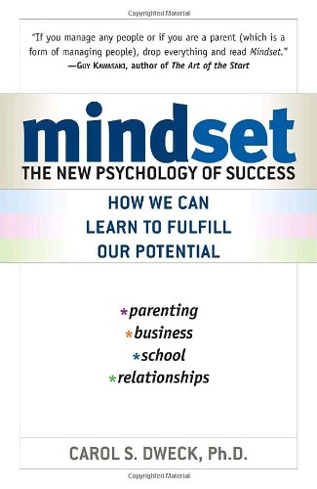
Narrowing the Achievement Gap
Promising Research on Academic Mindset Interventions
  Minority students show larger gains in GPA
  Girls show larger gains with math or science performance
  Lower rate of drop-out with college students
“Teaching Adolescents to Become Learners”
Notes:
Equity for all students?
Particularly effective during times of transition – starting middle school, starting high school, and starting college
(Good, C., Aronson, J., & Inzlicht, M. (2003). Improving adolescents' standardized test performance: An intervention to reduce the effects of stereotype threat. Applied Developmental Psychology, 24, 645-662.) – girls and math
(Aronson, J., Fried, C. B., & Good, C. (2002). Reducing the effects of stereotype threat on African American college students by shaping theories of intelligence. Journal of Experimental Social Psychology, 38, 113-125.)

Slide 13
What sorts of barriers or drawbacks could you envision regarding the growth mindset?

Slide 14
Other considerations
Grit has potential risks
  Persevering for unworthy goals
  Persevering based on fear
  Inappropriately attributing lack of success to lack of grit
Growth of academic mindset can be hindered
  Students who have experienced trauma?
  Lack of support and resources
“Promoting Grit, Tenacity, and Perseverance”
Notes:
Not important, extrinsically motivated, inappropriate = stress anxiety, distraction

Slide 15

Test your Mindset!
Mindset test online

Slide 16

The role of the school counselor
Notes:
Research into what it is and why it is relevant
Research often mentions what teachers can do in classrooms…
What is the school counselor’s role in all of this?

Slide 17
ASCA national model competencies
I belong in the academic community
My ability and competence grow with effort
I can succeed at this
This work has value for me
n II-C-3. Promotes and supports academic achievement, career planning and personal/social
development for every student
n IV-B-2g. Understands methods for helping students monitor and direct their own learning and personal/social and career development
Notes:
When we look at ASCA – Fostering an academic mindset are supported by many of the ASCA competencies. This work fits right in with what we strive to do as school counselors. Fostering this academic mindset can tie together social-emotional learning, academic achievement, and finally career development
Just a couple competencies that could relate to the topic + the core of academic mindsets

Slide 18

Integrate and Implement
Key goals
  Normalize academic difficulty
  Bolster student’s sense of belonging
  Reinforce a growth mindset
  Improve student perception of context
“Teaching Adolescents to Become Learners”
Notes:
Our role in fostering non-cognitive skills but especially academic mindsets
Idea that all students experience challenges and learning can be very difficult – when things get difficult it’s not that you are dumb – people have to put in effort
Tied to “I belong in this academic community” – Feeling that they have a place and fit is key here
Reinforce a growth mindset- Will go into specific interventions more – but as we were talking about – the plasticity of the brain – “your ability and competence can grow with effort”
Stop the cycle – negative mindsets – lower self-efficacy – less academic behavior and performance. Could help student re-examine how they see things…help them see it more realistically and therefore do better?

Slide 19
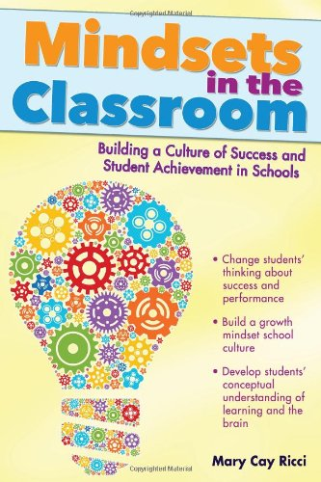

Integration into Interventions: Tier 1
  Classroom guidance
    Brainology
    OSPI
  Mentoring program
    Example: college students with 7th graders
  School initiatives
Student Academic Mindset Interventions
Notes:
Random assignment of middle school students in California found that Brainology led to a .21 increase in grade point average and to improved behavior (Romero, Paunesku, & Dweck,n.d.)
Mentoring college to 7th graders 2 90min sessions + relating it themselves .71– Good Aronson & Inzlicht, 2003
Scored significantly higher on state assessments than control students (incremental theory of intelligence and attribution messages “everyone experiences difficulty in 7th grade)

Slide 20
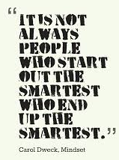
Integration into Interventions: Tier 2
Counseling groups
  Why Try
Workshop
Notes:
7. Teach them that hard work goes further
than natural talent.
Unit on growth mindset
I can succeed, I belong, college minority students gave speeches that they would give to freshman talking about the challenges they would face
http://onlinelibrary.wiley.com.ezproxy.library.wwu.edu/enhanced/doi/10.1111/j.1467-8624.2007.00995.x/
In Study 2, an intervention teaching an incremental theory to 7th graders (N=48) promoted positive change in classroom motivation, compared with a control group (N=43). Simultaneously, students in the control group displayed a continuing downward trajectory in grades, while this decline was reversed for students in the experimental group.
Workshop low-income, low achieving + problems of stereotyping oneself and malleability of intelligence. .3 higher at the end of the year – Blackwell et al. 2007

Slide 21

Integration into Interventions: at any tier
Letter
Values Essay
Attribution Intervention
“Student Mindset Interventions”
Notes:
Pen-pals – university students “writing” to younger students about encouragement + they learned about how brain grows like a muscle – AA and white had higher GPA and reported enjoying and valuing academics more .3 up for AA and .2 for White
Values essay – ethnic minority students wrote about a value that was important to them – increase in grade point averages reduced grades gap between AA and white by 40% – Cohen, Garcia, Apfel, & Master 2006
College kids learned about anxiety in college and how it reduces over time to freshmen (first watched video) – gap closed by 52%
College freshman – difficulties subside, upperclassmen discussing their college experiences. – higher GPA 80% less likely to drop out…gained strength with each term of college.

Slide 22
Collaboration & Education
School Context
Level of academic challenge
Teacher’s expectation for success
Clarity and relevance of learning goals
Availability of supports for learning
Grading structure and policy
For Parents
Let your child experience failure
Praise effort not ability
Scaffold difficult tasks
“Teaching Adolescents to Become Learners”
“The Perils and Promise of Praise”
Notes:
Possibly something to have at the back of one’s mind when doing student-teacher meetings?
(Kids with puzzles: growth praise v non growth praise – fixed mindset – did worse and picked less challenging, growth mindset praise – did better, picked more challenging puzzles).
Praising students' strategies, focus, effort, persistence, and improvement "takes the spotlight off fixed ability and puts it on the process of learning," Ms. Dweck said.
http://www.edweek.org/ew/articles/2013/09/11/03mindset_ep.h33.html
Other ideas?

Slide 23
Application
How are noncognitive factors already being developed at your internship sites?
Could you see ways to implement more noncognitive factor development?

Slide 24
Questions? Comments?

