Slide 1
Increasing Parent Involvement
Brianne N. Gregory
Western Washington University

Slide 2
What would you like to know about increasing parent involvement?
Make a quick note about two or three things you are curious about or have questions about…

Slide 3
Learning Targets
Be able to define what parent involvement looks like generally and at each level of education
Understand barriers that may affect levels of involvement among parents
Become familiar with the current research
Understand potential strategies for increasing parent involvement at your site
Become familiar with potential strategies for accommodating families struggling with cultural barriers

Slide 4
What is Involvement?
Under NCLB: “…the participation of parents in regular, two-way, and meaningful communication involving student academic learning and other student activities…”
Attendance at:
Conferences
Open Houses
Family Nights
Student events (sports, concerts…)
PTA Membership
Volunteering
Involvement with schoolwork in the home

Slide 5
Yeah, so? Why is it important?

Slide 9
Barriers to Involvement
Busy work schedule

Slide 10
Barriers to Involvement
Busy work schedule
Single parenthood

Slide 11
Barriers to Involvement
Busy work schedule
Single parenthood
Lack of resources
Transportation
Child care

Slide 12
Barriers to Involvement
Busy work schedule
Single parenthood
Lack of resources
Transportation
Child care
Language barrier/Cultural Isolation

Slide 13
Barriers to Involvement
Busy work schedule
Single parenthood
Lack of resources
Transportation
Child care
Language barrier/Cultural isolation
Low education level

Slide 14
Barriers to Involvement
Busy work schedule
Single parenthood
Lack of resources
Transportation
Child care
Language barrier/Cultural Isolation
Low education level
Not knowing how to contribute

Slide 15
Barriers to Involvement
Busy work schedule
Single parenthood
Lack of resources
Transportation
Child care
Language barrier/Cultural Isolation
Low education level
Not knowing how to contribute
Feeling overwhelmed, intimidated, or unwelcome

Slide 16
Getting Involved at Every Level
Offer parent events at varied times
Offer parent trainings through things they request on surveys
Offer child care during parent events
Provide a meal during your events
Monthly newsletter
Parent orientations
Set families up with community resources
Parent Appreciation Day
Make it a mutual partnership with common goals

Slide 17
Educate Parents…
What does the research say?
Perhaps use video educational tools in other languages:
https://www.youtube.com/watch?v=3_-aLWOk9Og&feature=player_detailpage
Gives them the feeling of expertise

Slide 18
Educate Ourselves!
Parent Surveys:
Parental Support
Child Behaviors
Parent Engagement
Parent Self-Efficacy
School Climate
Parent Roles and Responsibilities
What do they need from us?

Slide 19
Elementary School
Grade level music performances
Santa Breakfast
Photo time at Christmas
Invite parents to visit classrooms
Invite them to assemblies
Be warm and welcoming
Share what you really like about their child
Openly communicate with them, but don’t overwhelm

Slide 20
Family Nights: Why?
Opportunity to share own experiences and knowledge

Slide 21
Family Nights: Why?
Opportunity to share own experiences and knowledge
Shows that the school still sees the parent as the expert on their child

Slide 22
Family Nights: Why?
Opportunity to share own experiences and knowledge
Shows that the school still sees the parent as the expert on their child
A range of topics to catch diverse interests

Slide 23
Family Nights: Why?
Opportunity to share own experiences and knowledge
Shows that the school still sees the parent as the expert on their child
A range of topics to catch diverse interests
A focus on learning from as well as with families

Slide 24
Family Nights: Why?
Opportunity to share own experiences and knowledge
Shows that the school still sees the parent as the expert on their child
A range of topics to catch diverse interests
A focus on learning from as well as with families
Opportunity to give parents strategies to support their child’s learning at school, at home

Slide 25
Family Nights: Why?
Opportunity to share own experiences and knowledge
Shows that the school still sees the parent as the expert on their child
A range of topics to catch diverse interests
A focus on learning from as well as with families
Opportunity to give parents strategies to support their child’s learning at school, at home
Strengthen the relationship between families and the school

Slide 26
Family Nights: Why?
Opportunity to share own experiences and knowledge
Shows that the school still sees the parent as the expert on their child
A range of topics to catch diverse interests
A focus on learning from as well as with families
Opportunity to give parents strategies to support their child’s learning at school, at home
Strengthen the relationship between families and the school
Increase the level of comfort families have with interacting with the school

Slide 27
Family Night Ideas:
Scrapbook Night: Encourage families to share family photos and memories with you as they create scrapbook pages they can treasure forever
Reading Night: Provide many books to read; Teach parents strategies for reading with their children at home
Family Movie Night: A low-risk activity to encourage skeptical, less involved parents to become more engaged in school activities
These are only a few ideas of many!!!

Slide 28
Middle School
Engagement often decreases
Communication x 3!
Welcoming, knowledgeable staff that wants to build relationships with families
Provide concrete ways parents can be involved at your school
Talent Shows, Concerts
Ask them to participate!
Begin to educate parents about the graduation, post-secondary process

Slide 29
High School
Help aide and teach parents early on about graduation and post-secondary options
Freshman Parent Orientation
College Night: How can you help your child get there?
Family Information Nights about college, FAFSA, AP and Honors courses, and career options)
Educate them about how much their involvement can affect their child’s future
Collaboration between schools and parents to support career exploration such as job shadowing
Teach parents how to support their students at home

Slide 30
Supporting Your Child at Home
Learn about your child’s school

Slide 31
Supporting Your Child at Home
Learn about your child’s school
Find out about the homework policy

Slide 32
Supporting Your Child at Home
Learn about your child’s school
Find out about the homework policy
Help your child get organized

Slide 33
Supporting Your Child at Home
Learn about your child’s school
Find out about the homework policy
Help your child get organized
Keep in touch with the school and teachers

Slide 34
Supporting Your Child at Home
Learn about your child’s school
Find out about the homework policy
Help your child get organized
Keep in touch with the school and teachers
Monitor you student’s grades

Slide 35
Supporting Your Child at Home
Learn about your child’s school
Find out about the homework policy
Help your child get organized
Keep in touch with the school and teachers
Monitor you student’s grades
Make rules for homework

Slide 36
Supporting Your Child at Home
Positive reinforcement

Slide 37
Supporting Your Child at Home
Positive reinforcement
Have “study time” or a “study spot” which has no distractions and is conducive to learning

Slide 38
Supporting Your Child at Home
Positive reinforcement
Have “study time” or a “study spot” which has no distractions and is conducive to learning

Slide 39
Working with Diverse Families and Families of Poverty
Provide child care
Provide a meal or snacks at your event
Have several translators at the event
NEVER speak to a translator
Understand cultural respectful behaviors
Speak to the man, but include the woman
Reciprocity; mutual sharing

Slide 40
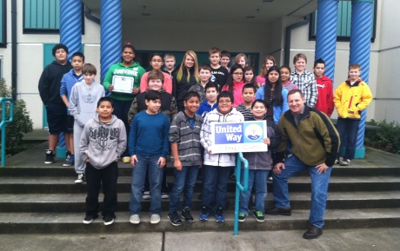
Home Visits
Purpose:
District goal: To engage families to provide encouragement and support to students, ensuring that students needs are met and their educational opportunities are enhanced
Our immediate goals:
To find out “the hopes and dreams” each parent has for their child and how we can support that dream
Build deeper relationships with families

Slide 41
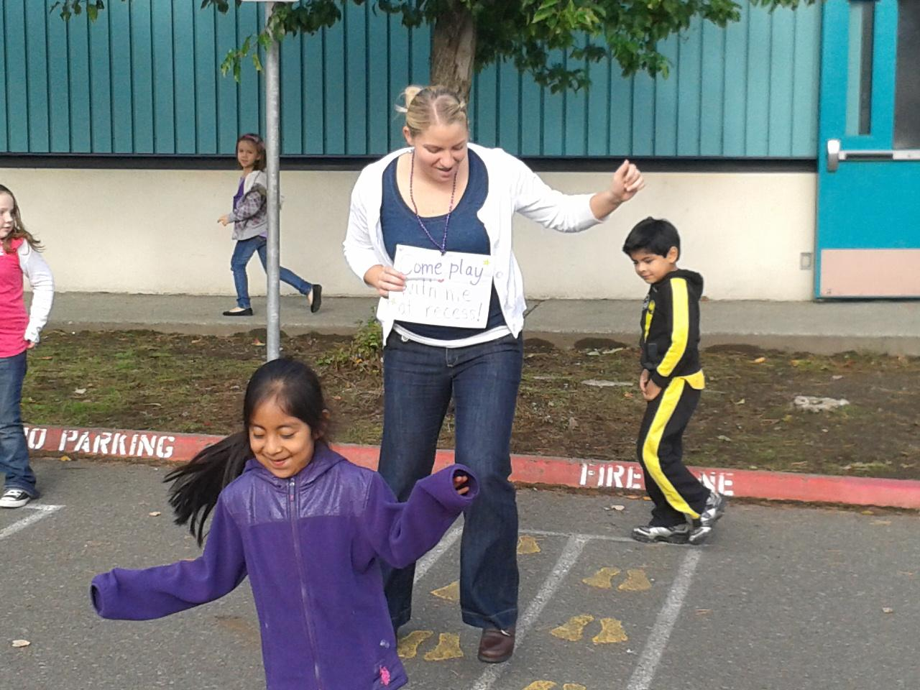
My Experience

Slide 42
How exactly can we use PI?
Fishel & Ramirez
Looked at 24 studies of PI academic interventions (individual level)
Found no sufficient evidence that PI interventions in general are effective as a whole
What were the interventions: Mostly home tutoring, reading together
Populations
Did not include High School-aged students
Very diverse groups of students racially, culturally, and ability-wise
Do not rule anything out! Issues of methodology and research in studies
On a larger scale of intervention, strategies that showed more likely to yield academic improvement are:
Combination of peer and parent tutoring
Parent tutoring with focus on specific reading problems
What is your take-away from this?

Slide 43
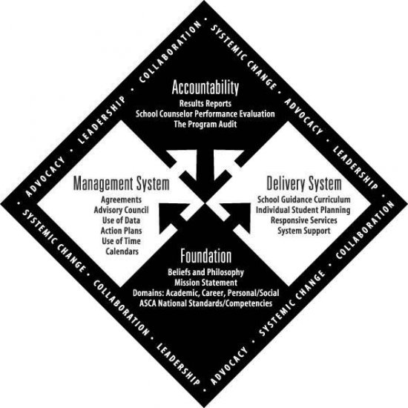
ASCA National Model
Counselors should have ready, personal connections with parents
Collaborate and team with others to best plan for students’ success
Help parents support their student’s academic, social/emotional, personal, and career development at home

Slide 44
ASCA National Model
SC Program should:
Provide support for parents in advocating for their child’s needs
Increase opportunities for parent/school interaction
Enable parents to access school and community resources

Slide 45
ASCA National Model
SC Program should:
Provide support for parents in advocating for their child’s needs
Increase opportunities for parent/school interaction
Enable parents to access school and community resources
Does this mean you are on your own in the task of increasing parent involvement?

Slide 46
ASCA National Model
SC Program should:
Provide support for parents in advocating for their child’s needs
Increase opportunities for parent/school interaction
Enable parents to access school and community resources
Does this mean you are on your own in the task of increasing parent involvement?

Slide 47
ASCA National Model
SC Program should:
Provide support for parents in advocating for their child’s needs
Increase opportunities for parent/school interaction
Enable parents to access school and community resources
Does this mean you are on your own in the task of increasing parent involvement?

Slide 48
ASCA National Model
SC Program should:
Provide support for parents in advocating for their child’s needs
Increase opportunities for parent/school interaction
Enable parents to access school and community resources
Does this mean you are on your own in the task of increasing parent involvement?

Slide 49
ASCA National Model
SC Program should:
Provide support for parents in advocating for their child’s needs
Increase opportunities for parent/school interaction
Enable parents to access school and community resources
Does this mean you are on your own in the task of increasing parent involvement?

Slide 50
ASCA National Model
SC Program should:
Provide support for parents in advocating for their child’s needs
Increase opportunities for parent/school interaction
Enable parents to access school and community resources
Does this mean you are on your own in the task of increasing parent involvement?

Slide 51
ASCA National Model
SC Program should:
Provide support for parents in advocating for their child’s needs
Increase opportunities for parent/school interaction
Enable parents to access school and community resources
Does this mean you are on your own in the task of increasing parent involvement?

Slide 52
Using Our Data
This survey is indicative of most of the parents’ responses in the SuperAwesome School, where you are a school counselor. What interventions might you and your team decide upon based on this data? What will you focus on?
School population: 55% Latino, 40% White, 75% Free & Reduced Lunch, 50% of families have at least one Spanish speaking parent
Will your interventions differ at each level? If yes, what would they look like?
Elementary School
Middle School
High School

Slide 53
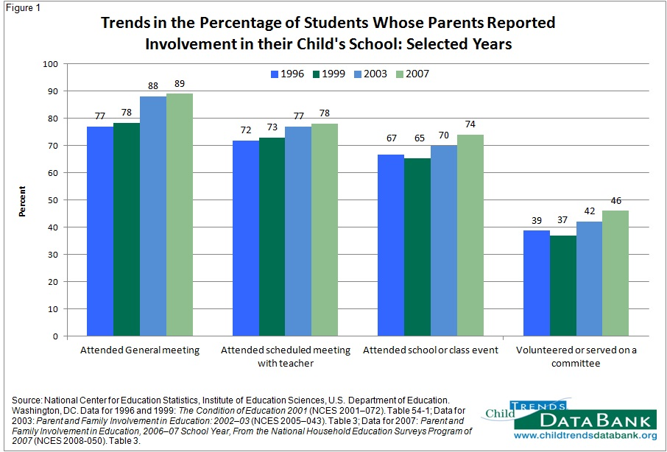

Slide 54
Summary
Parent involvement has many benefits for student academic achievement
Minority families participate in child’s school and education less often.
Schools are getting better at involving parents.
Counselors can play a large role by aligning with the goals for parent-school involvement and relationships as outlined by the ASCA National Model

Slide 55
Resources
http://www.parentinvolvementmatters.org/resources/programs.htm
http://www.ptotoday.com/parent-involvement
http://www.childtrendsdatabank.org/
Fishel, M., & Ramirez, L. (2005). Evidence-based parent involvement interventions with school-aged children. School Psychology Quarterly, 20(4), 371-402. doi:10.1521/scpq.2005.20.4.371
Kyle, D. W., McIntyre, E., Miller, K. B., & Moore, G. H. (2006). Bridging school & home through family nights: ready-to-use plans for grades k-8. Thousand Oaks, CA: Corwin Press.

