Slide 1
Bullying and School Violence
Kaitlin Davis

Slide 2
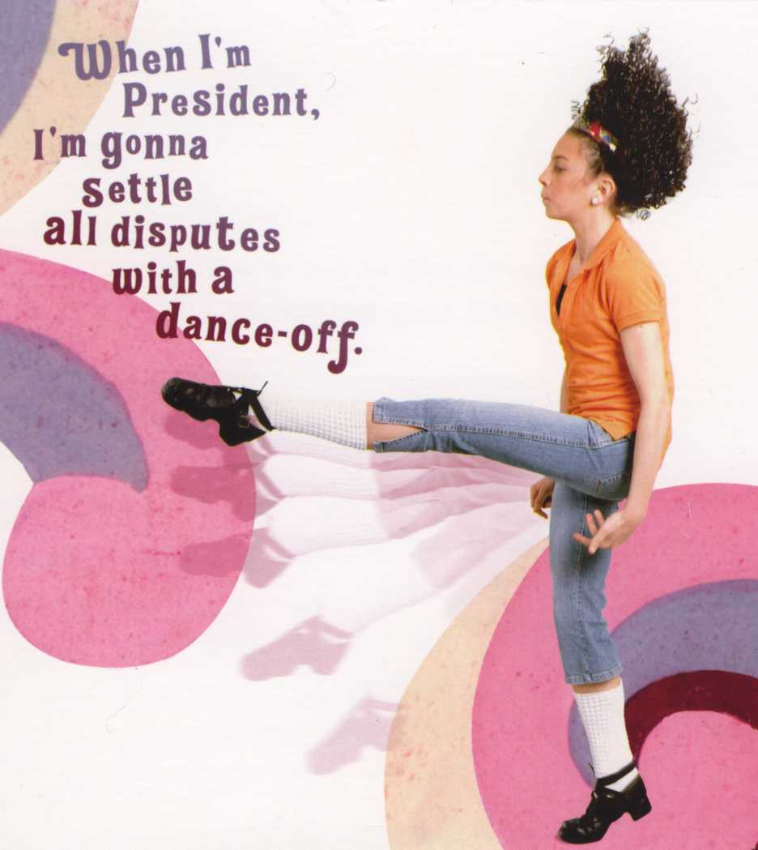

Slide 3
Agenda
Introduction
Root of violence
School Counselor role
Data and assessment
Response: Laws, ethics, and procedures
Prevention
Best Practices
Examples

Slide 4
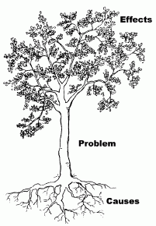
Problem Tree

Slide 5
Sources of Power
Gender
Delegated authority
Social class
Resource currency (Money, food, property)
Personal or group charisma
Ascribed power (acting on perceived or assumed abilities)
Expertise (ability, skills)
Persuasion
Knowledge (granted or witheld)
Celebrity
Force (violence, military might, coercion)
Moral persuasion (i.e. religion)
Operation or manipulation of group dynamics (i.e. public relations)
Tradition
Domination/submission

Slide 6
Types of Violence
Bullying/Cyber
Harassment
Intimidation
Sexual harassment
Dating violence
Witnessing domestic violence
Gang violence
Racial/ethnic discrimination
Institutionalized racism and sexism
Micro-aggressions
Hate crimes
Sexual Assault
“Violence is anything that denies human integrity and leads to hopelessness and helplessness.” ~Martin Luther King, Jr.

Slide 7
Impact
Feeling Powerless
Internalized
Externalized
Trauma
Development
Academics
Attendance
Feeling emotionally and physically unsafe
Contribute to mental illness

Slide 8
Trends
Rising concern, but decreasing rates
Overall crime rate 1993-1997 155 crimes/1,000 students
Fewer injuries due to violence, fewer weapons and physical fights on school grounds (U.S. Department of Education, 1999)
12-18 more likely to be victims away from school (National Center for Education Statistics, 2000)
“Typical” trend of adolescent violence: inner-city, clear dispute, low SES, economic, territorial, or retaliation motive (McWhirter, 2004)
“Atypical” school shootings: suburbs, small towns, rural areas, affluent, intact families, academically capable, White (McWhirter, 2004)
Students do not feel safe at school (37% don’t feel safe, 45% avoided school grounds, and 43% avoided rest rooms, 20% avoided hallways.

Slide 9
School Counselor Role
Federal Law:
The No Child Left Behind (NCLB) Act of 2001 requires states to address bullying
Safe and drug free schools funding
State Law: WAC
Prohibits HIB
District primary contact
Liaison with Educational Ombuds
ACA/ASCA Ethics Code
OSPI: Safety Center

Slide 10
Food for thought
What types of violence do you see in your internship site?
What is the role of the school counselor at your site?

Slide 12
Bullying--Definition
Victims are exposed repeatedly and over time
From one or more other students
Intent to distress or harm the victim
Power imbalance often exists (physical or social)
Negative actions can range from nonverbal (ie, ostracism) to overt (ie, punching, throwing objects, vandalism).
(Olweus as cited in Blosnich & Bossarte, 2011)

Slide 13
Bullying--Prevalence
% Whatcom County youth bullied in the last 30 days (Healthy Youth Survey, 2008).
16% of 12th grade
23% of 10th grade
27% of 8th grade
27% of 6th grade
% U.S. public schools who reported experiencing at least one bullying incident per week (National Center for Education Statistics, 2004).
24% of Primary
42% of Middle
21% of High School

Slide 14
Bullying Prevention Programs
Two Types
Curriculum (i.e. Responding in Peaceful and Positive Ways)
Statistically significant results, especially provocation and physical
Small effect size, not maintained
Whole-school: (i.e. Positive Behavior Support)
School-based programs can be effective (20%-50% reduction in reports)
Variations in the effects of different programs.
Olweus-inspired programs most effective http://www.olweus.org/public/testimonials.page
High quality instruction!

Slide 15
Strategies that do not work
Social skills training for victims
Peer mediation (poorly designed)
“0 Tolerance” discipline policies
Safety measures (on their own)

Slide 16
Using Multi-media for Prevention:
Social Norms Campaigns: R.E.S.P.E.C.T Video: http://www.youtube.com/watch?v=iGuT9-_Y5J4
Video Memoirs
Not In Our Town student empowerment http://www.niot.org/nios-video/students-take-cyberbullying
Songs and poems for discussion http://www.youtube.com/watch?v=lgT1AidzRWM http://www.youtube.com/watch?v=VdUBjFeWxfU

Slide 17
Educating Parents
Monitoring (including internet)
Established family rules
Rights and responsibilities
Filtering/blocking media
Searches
Know and look for warning signs
Offer training
Cyber safety program at www.netsmartz.org

Slide 18
Working with Aggression
Youth aggression is ecological and developmental (64% of school counselors did not know this)
Individual variables
School variables
Roots in family structure: child-leadership, lack of parental modeling, direction, and support, strict boundaries, family violence and threats
Reactive (escalation): Counseling at triggering, escalation, and post-crisis stage, NOT crisis stage or recovery stage—use firm direction.
Proactive aggression
(McAdams, Shillingford, and Trice-Black, 2011)

Slide 19
Addressing Risk for Persistent Offending
Risk factors (ages 8-18) that predicted persistance after age 21: (Longitudinal, n=411, London, Males)
Heavy drinking at age 18
Hyperactivity at ages 12-14
Low popularity and harsh discipline at ages 8-10
Risk factors that predicted non-offenders would onset after 18 were:
Poor housing ages 8-10
Low nonverbal IQ ages 8-10
High neuroticism at age 16
Anti-establishment attitudes and motoring convictions at 18

Slide 20
Student Monitoring
Having adults and/or staff supervising hallways associated with lower reports
Cameras/security guards not as effective as teachers
Difficult to determine effectiveness because schools using safety measures, such as cameras, may already be experiencing higher levels of bullying

Slide 21
Coaching Executive Functions
Initiation: organizing thoughts well enough to get started on a task
Flexibility: Shifting focus and pace as situations unfold
Attention: Focusing long enough and accurately enough to learn important information. Also, blocking distraction and discerning priorities.
Organization: Managing space—a chaotic environment has an emotional impact!
Planning: Managing time, finishing things on time
Working memory: Retaining information long enough for it to be stored long-term key for learning and for other other executive functions
Self-awareness: Sufficient self-knowledge and understanding of how one is seen by others. Key for making purposeful choices about how to act in situations where one wants to avoid unintended consequences that lead to isolation or ostracism.
Managing emotions: Expressing feelings in proportion (silent recluse vs. erupting volcano.)

Slide 22
Key Messages
To offenders: NOT OK!, CAUSES REAL HARM, REAL CONSEQUENCES
To victim: NOT YOUR FAULT!, YOU ARE NOT POWERLESS
To bystanders: STAND UP!, LISTEN
To families: BE AN ALLY and ROLE MODEL, SUPERVISE
To schools and communities: PROVIDE SAFE SPACE, TAKE VIOLENCE SERIOUSLY, ALL FORMS, ALL VICTIMS, ALL OFFENDERS
To global citizens: WE ARE INTERCONNECTED, WE ARE NOT OUR STEREOTYPES
To allies: THANK YOU!

